Slide 1
Portfolio Case Study
Nicholas de clercq

Slide 2
Contents
Problem outline
Current portfolio Characteristics
Return analysis
Risk analysis
ESG analysis
Concluding remarks

Slide 3
Problem outline
This project explore the characteristics, risk dynamics and ESG profile of an equity portfolio provided. All analytics are performed in python with results designed to demonstrate both technical proficiency and interpretive insight.

Slide 4
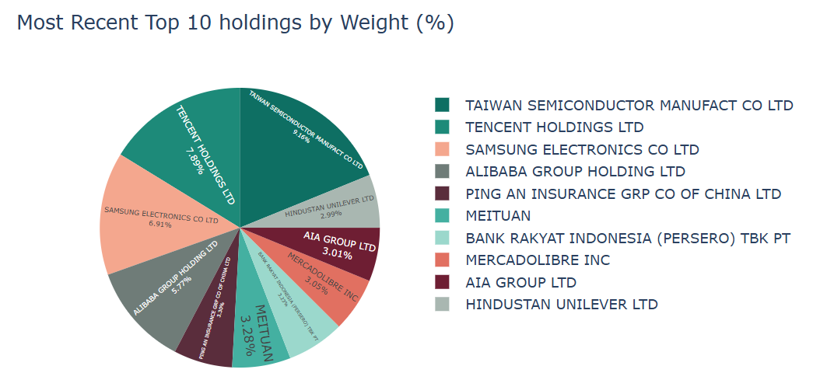
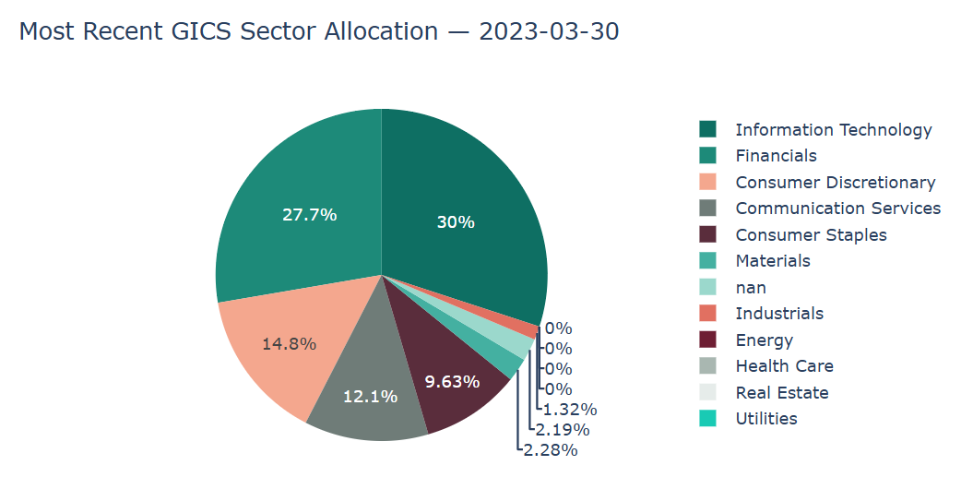
Current Portfolio Characteristics

Slide 5
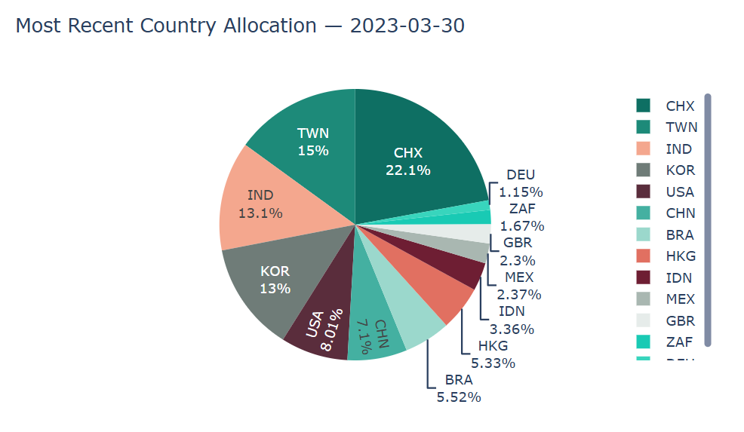
The portfolio is broadly exposed to both emerging market and developed market economies with the majority coming from emerging market countries such as India and China. This is not atypical for a global fund with focus on the MSCI emerging market index.

Slide 6
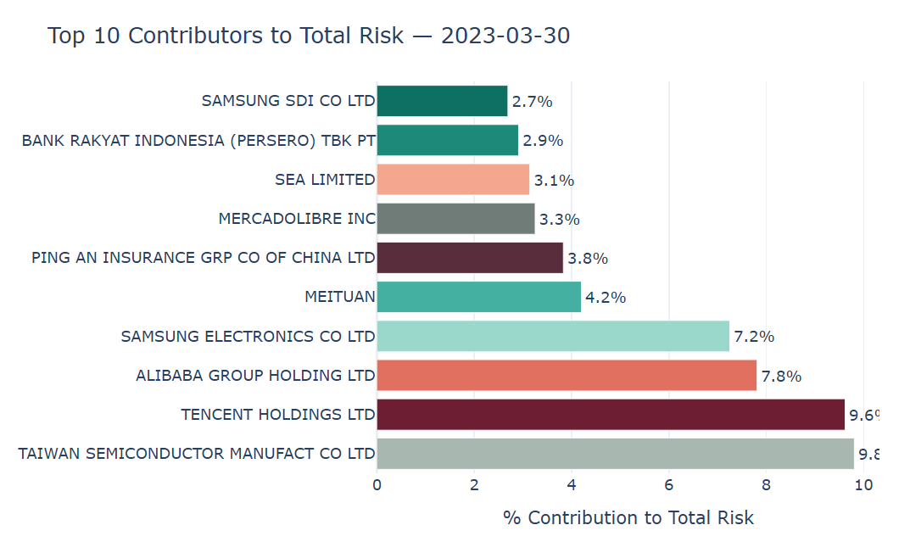
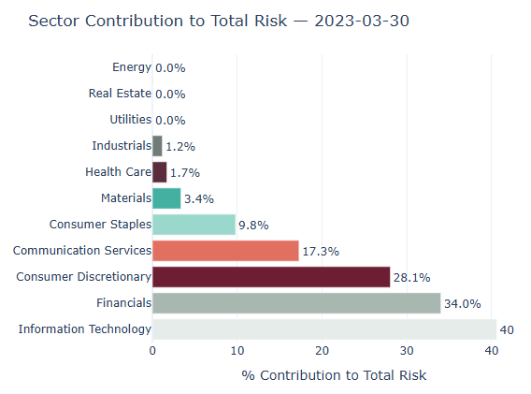
Current Risk Drivers

Slide 7
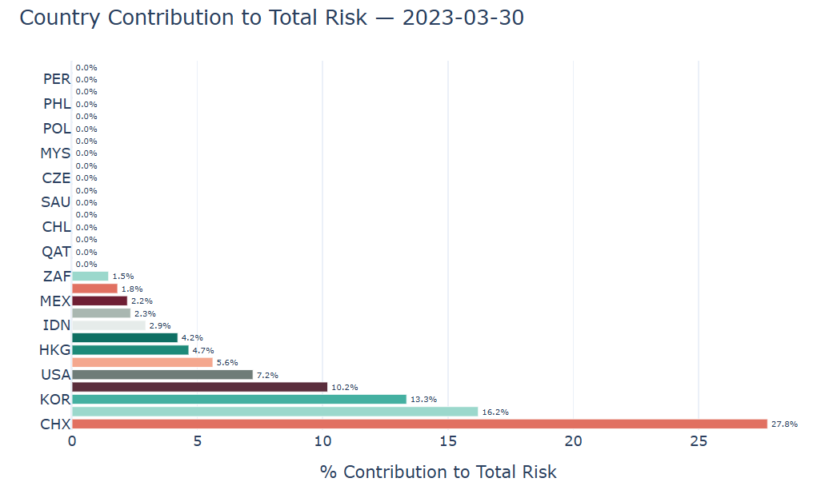
The current drivers of risk are unsurprisingly dominated by the shares, sector and countries that the portfolio is most exposed to.

Slide 8
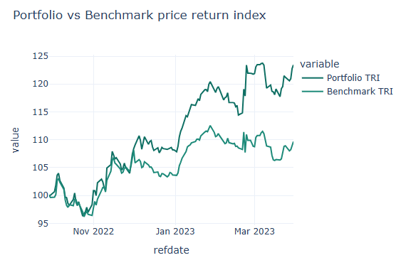
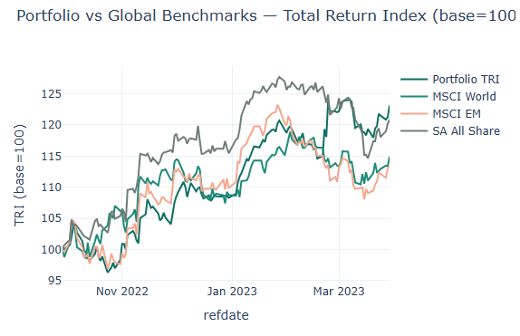
Portfolio Return Analysis

Slide 9
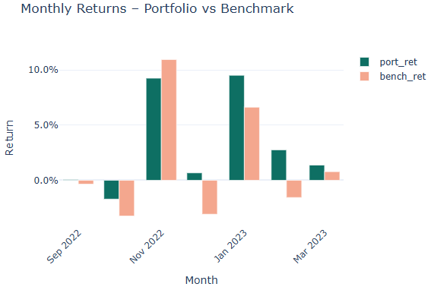
The portfolio is an actively managed fund with active weights against its benchmark. Over the period of 29 Sep 2022 to 29 Mar 2023, the fund has managed to outperform its benchmark as well as the MSCI world, the MSCI emerging market index and the JSE All Share index. Showing impressive skill from the fund manager.

Slide 10
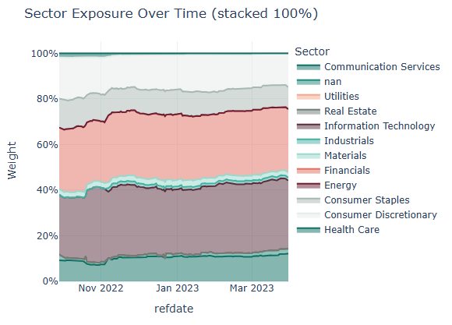
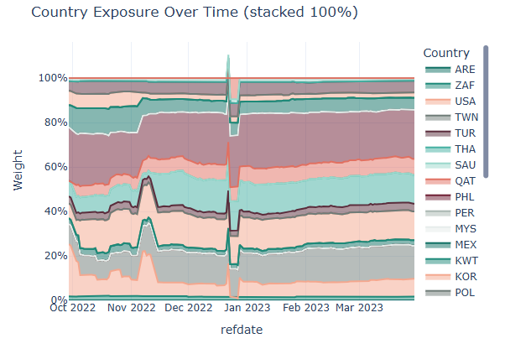
Exposures over time

Slide 11
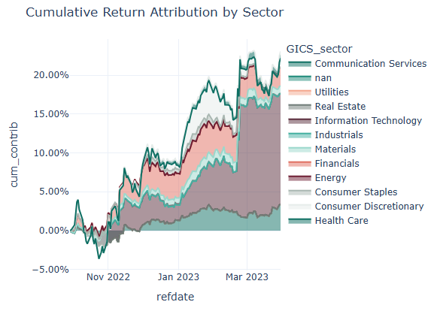
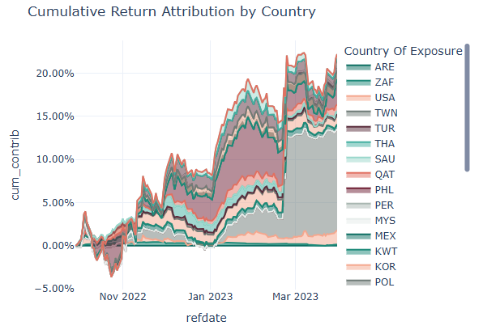
Return Attribution

Slide 12
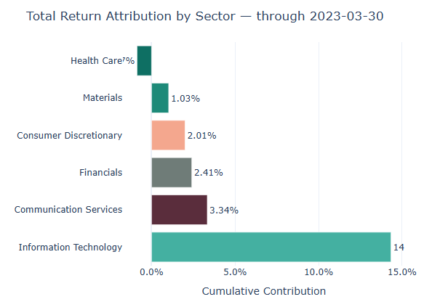
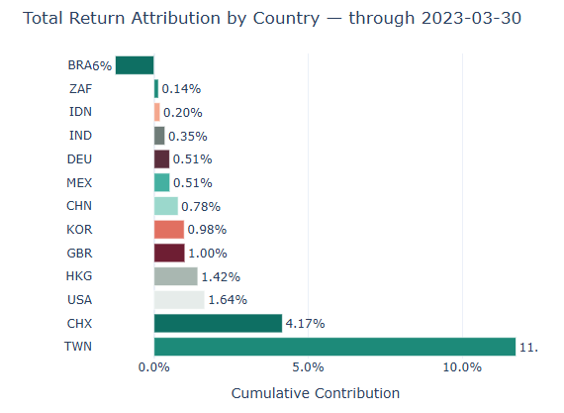
Attribution continued

Slide 13
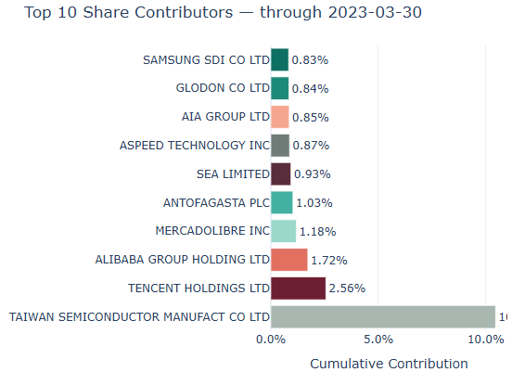
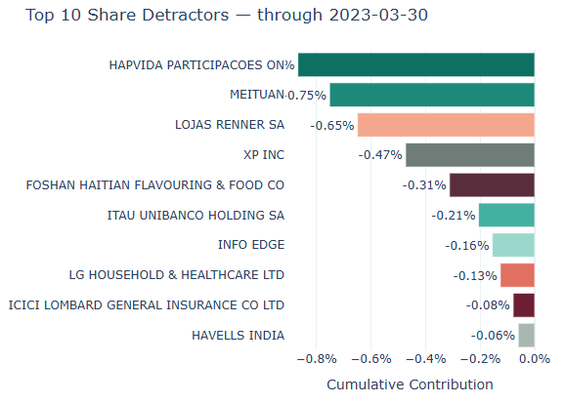
Share Attribution

Slide 14
Return attribution Comments
It is clear that the information technology sector made the majority of the gains with a meaningful contribution from the communication services sector. China and Taiwan delivered the majority of the positive performance with Brazil the only large negative contributing region.
Taiwan Semiconductor manufact co was the notable performer over the period with a return of 10.5%. Tencent and Alibaba making meaningful contributions as well. On Hapvida and Meituan were the most negative detractors to performance.

Slide 15
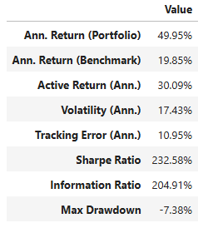
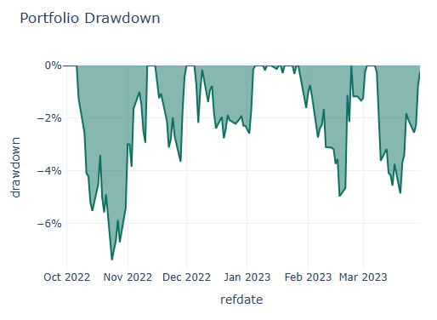
Risk Analysis

Slide 16
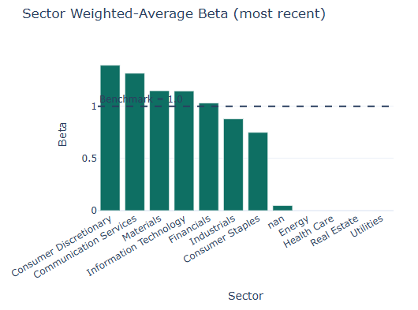
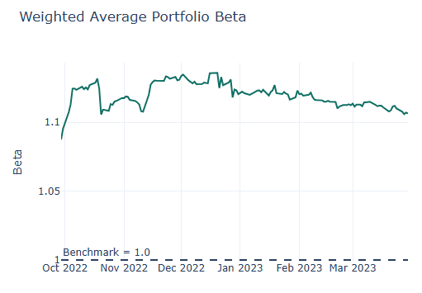
Beta analysis

Slide 17
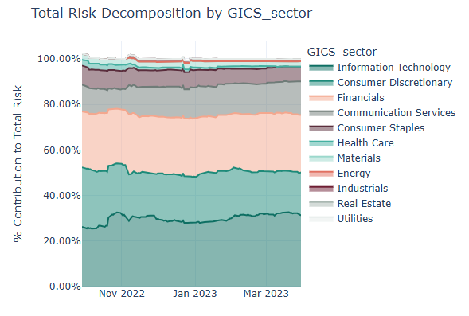
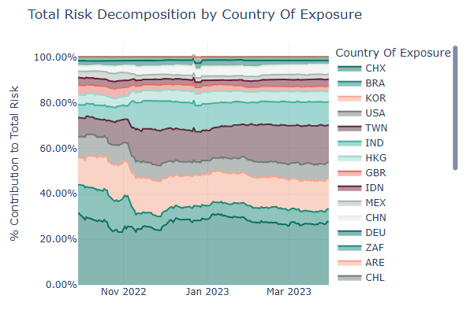
Risk attribution

Slide 18
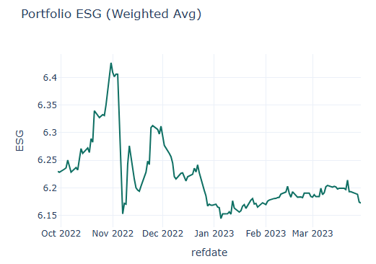
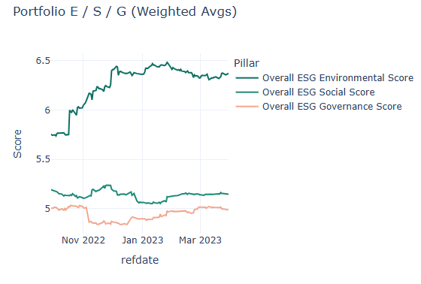
ESG analysis

Slide 19
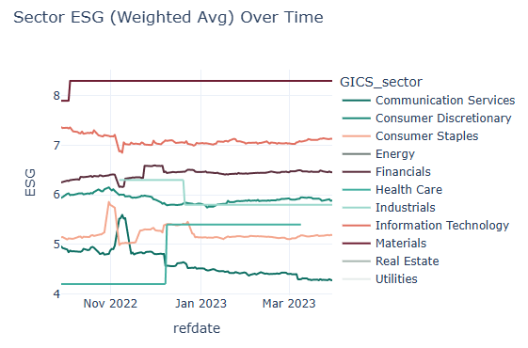
The portfolio is ESG cognisant with a focus on the environmental pillar of ESG. The overall ESG score decreased slightly over the period due to a slight decrease in weighted governance score. While the environmental pillar continued to improve over the period.

Slide 20
Closing remarks
This is an actively managed equity portfolio with a global, and specifically emerging market, focus. It is clearly ESG-conscious, with particular emphasis on the environmental pillar of ESG.
The portfolio manager has successfully generated alpha relative to the benchmark and has also outperformed global equity indices that may be relevant for peer comparison. Its concentration in the Information Technology sector, particularly in Taiwan, has driven the majority of returns over the period.

Slide 21

Thank you!

